Slide 1


Slide 2



Ratios, Proportions and Variations Quiz
https://qrgo.page.
link/WL1w5

Slide 3
MIXTURES AND ALLIGATIONS

Slide 4

Concepts:
Alligation: It is the rule that enables us to find the ratio in which two or more ingredients at the given price must be mixed to produce a mixture of desired price.
Mean Price: The cost of a unit quantity of the mixture is called the mean price.
Rule of Alligation: If two ingredients are mixed, then

Slide 5
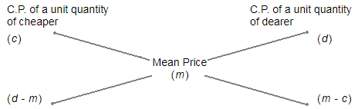
Concepts:
(Cheaper quantity) : (Dearer quantity) = (d - m) : (m - c).
Suppose a container contains x of liquid from which y units are taken out and replaced by water.
After n operations, the quantity of pure liquid = [x(1-(y/x))^n] units

Slide 6
Question 01:
In what ratio must rice at Rs 9.30 per kg be mixed with rice at
Rs 10.80 per kg so that the mixture be worth Rs 10 per kg?
A. 6:5
B. 8:7
C. 3:7
D. 6:1
Answer: B

Slide 7
Explanation:
C.P of 1 Kg C.P of 1 Kg
rice of 1st rice of 2nd
kind (930p) kind (1080p)
\ / Mean Price
(1000p)
/ \
(1080 – 1000) : (1000 - 930)
80 70
Thus, required ratio = 80 : 70 = 8 : 7

Slide 8
Question 02:
How much water must be added to 60 litres of milk at 1.5
litres for Rs. 20 so as to have a mixture worth Rs.10.23 a litre?
A. 10 litres
B. 12 litres
C. 15 litres
D. 18 litres
Answer: C

Slide 9
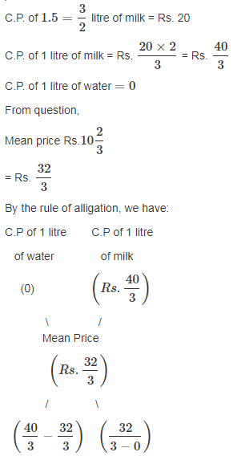
Explanation:

Slide 10
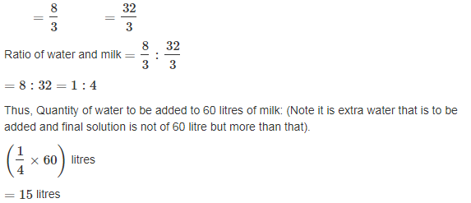
Explanation:

Slide 11
Question 03:
In what ratio must wheat at Rs. 3.20 per kg be mixed with
wheat at Rs. 2.90 per kg so that the mixture be worth Rs. 3.08 per kg?
A. 3 : 4
B. 2 : 3
C. 3 : 2
D. 4 : 3
Answer: C

Slide 12
Explanation:
C.P of a unit quantity of 1st kind = Rs. 3.20 C.P of a unit quantity of 2nd kind = Rs. 2.90 Mean price = Rs.3.08
C.P of unit quantity C.P of unit quantity
of 1st kind of 2nd kind
(Rs. 3.20) (Rs. 2.90)
\ / Mean Price
(Rs.3.08)
/ \
(3.08 – 2.90) : (3.20 – 3.08)
0.18 0.12
Required ratio = 0.18 : 0.12 = 3 : 2

Slide 13
Question 04:
In what proportion must rice at Rs. 3.10 per kg be mixed with
rice at Rs. 3.60 per kg so that the mixture be worth Rs. 3.25 per kg?
A. 3 : 7
B. 5 : 3
C. 3 : 5
D. 7 : 3
Answer: D

Slide 14
Explanation:
C.P of a unit quantity of 1st kind = 310p (in paise) C.P of a unit quantity of 2nd kind = 360p Mean price = 325p
C.P of unit quantity C.P of unit quantity
of 1st kind of 2nd kind
(310p) (360p)
\ / Mean Price
(325p)
/ \
(360 – 325) : (325 – 310)
35 15
Required ratio = 35 : 15 = 7 : 3 They must be mixed in the ratio 7 : 3

Slide 15
Question 05:
In what ratio must tea at Rs. 62 per kg be mixed with tea at
Rs. 72 per kg so that the mixture must be worth Rs. 64.50 per kg?
A. 1 : 3
B. 2 : 3
C. 3 : 1
D. 3 : 2
Answer: C

Slide 16
Explanation:
C.P of a unit quantity of 1st kind = Rs. 62 C.P of a unit quantity of 2nd kind = Rs. 72 Mean price = Rs. 64.50
C.P of unit quantity C.P of unit quantity
of 1st kind of 2nd kind
(Rs. 62) (Rs. 72)
\ / Mean Price
(Rs. 64.50)
/ \
(72 – 64.50) : (64.50 – 62)
7.50 2.50
Required ratio = 7.50 : 2.50 = 3 : 1

Slide 17
Question 06:
The ratio, in which tea costing Rs. 192 per kg is to be mixed
with tea costing Rs. 150 per kg so that the mixed tea when sold for Rs. 194.40 per kg, gives a profit of 20%.
A. 1:2
B. 2:5
C. 3:5
D. 3:7
Answer: B

Slide 18
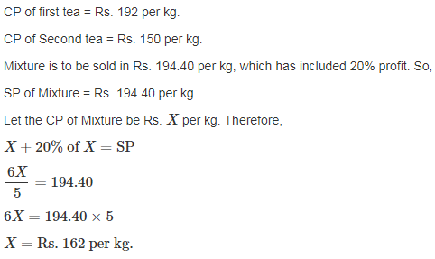
Explanation:

Slide 19
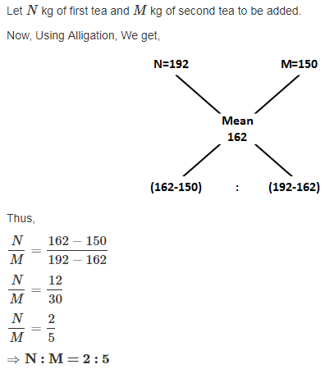
Explanation:

Slide 20
Question 07:
5 kg of rice at ` 6 per kg is mixed with 4 kg of rice to get a mixture costing ` 7 per kg. Find the price of the costlier rice.
7.25 /kg
7.75 /kg
8.25 /kg
9.35 /kg
Answer: C

Slide 21
Explanation:
Using the cross method: rice at Rs 6 per Kg rice at Rs x per Kg Mean price Rs 7 per Kg 5 : 4
x-7:1=5:4 4x-28 = 5 4x=33=>x=Rs 8.25. Therefore price of costlier rice is Rs 8.25 per Kg

Slide 22
Question 08:
In a 729 litres mixture of milk and water, the ratio of milk to water is 7:2.To get a new mixture containing milk and water in the ratio 7:3, the amount of water to be added is_________.
A. 51 litres
B. 61 litres
C. 71 litres
D. 81 litres
Answer: D

Slide 23
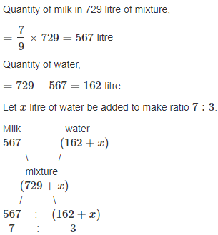
Explanation:

Slide 24
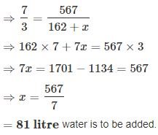
Explanation:

Slide 25
Question 10:
How many kilograms of sugar costing Rs. 9 per kg must be mixed with 27 kg of sugar costing Rs.7 per kg so that there may be gain of 10% by selling the mixture at Rs. 9.24 per kg?
A. 60 kg
B. 63 kg
C. 50 kg
D. 77 kg
Answer: B

Slide 26
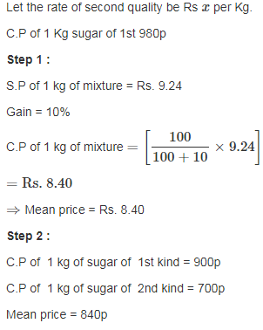
Explanation:

Slide 27
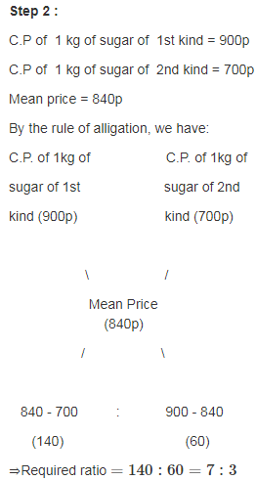
Explanation:

Slide 28
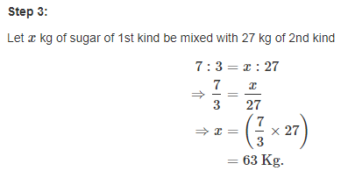
Explanation:

Slide 29
Question 11:
One quantity of wheat at Rs 9.30 per kg is mixed with another quality at a certain rate in the ratio 8:7. If the mixture so formed be worth Rs 10 per kg, what is the rate per kg of the second quality of wheat?
A. Rs. 12.47
B. Rs. 10.80
C. Rs. 15.17
D. Rs. 47.66
Answer: B

Slide 30
Explanation:
Let the rate of second quality be Rs x per Kg.
C.P of 1Kg wheat of 1st kind = 930p
C.P of 1 Kg wheat of 2nd kind = 100x p
Mean price = 1000p
By rule of alligation we have required ratio 8 : 7
930 x
\ /
(Mean Price) (10)
/ \
x-10 : 0.7 :: 8 : 7
we get required ratio, (x-10) : 0.7 :: 8 : 7
⇒ x = 10.80 per Kg

Slide 31
Question 12:
A can contains a mixture of two liquids A and B in the ratio 7:5. When 9 litres of mixture are drawn off and the can is filled with B, the ratio of A and B becomes 7:9. How many litres of liquid A was contained by the can initially?
A. 28 litres
B. 21 litres
C. 45 litres
D. 36 litres
Answer: B

Slide 32
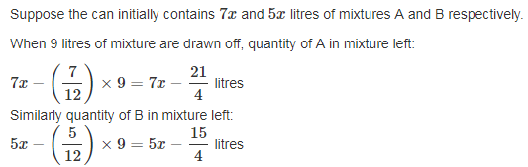
Explanation:

Slide 33
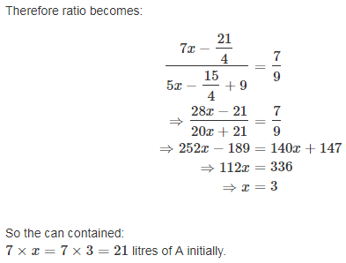
Explanation:

Slide 34
Question 13:
A container contains 40 litres of milk. From this container 4 litres of milk was taken out and replaced by water. This process was repeated further two times. How much milk is now contained by the container?
A. 26.34 litres
B. 27.36 litres
C. 28 litres
D. 29.16 litres
Answer: D

Slide 35
Explanation:
Amount of milk left after 3 operations = [40(1−4/40)³) litres
= (40×9/10×9/10×9/10) litres
= 29.16 litres

Slide 36
Question 14:
The cost of Type 1 rice is Rs. 15 per kg and Type 2 rice is Rs. 20 per kg. If both Type 1 and Type 2 are mixed in the ratio of 2 : 3, then the price per kg of the mixed variety of rice is:
A. Rs. 18
B. Rs. 18.50
C. Rs. 19
D. Rs. 16.50
Answer: A

Slide 37
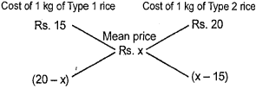
Explanation:
Let the price of the mixed variety be Rs.x per kg By the rule of ailigation we have ∴(x−15)/(20−x)​=32​ ⇒60−3x=2x−30⇒5x=90⇒x=18 So price of the mixture is Rs.18 per kg.

Slide 38
Question 09:
The milk and water in two vessels A and B are in the ratio 4:3 and 2:3 respectively. In what ratio the liquids in both the vessels be mixed to obtain a new mixture in vessel c consisting half milk and half water?
A. 8 : 3
B. 7 : 5
C. 4 : 3
D. 2 : 3
Answer: B

Slide 39
Explanation:
Milk in 1 litre mixture of A = 4/7 litre.
Milk in 1 litre mixture of B = 2/5 litre.
Milk in 1 litre mixture of C = 1/2 litre.
By rule of alligation we have required ratio X:Y

Slide 40
Explanation:
X : Y
4/7 2/5
\ /
(Mean ratio) (1/2)
/ \
(1/2 – 2/5) : (4/7 – 1/2)
1/10 1/1 4
So Required ratio = X : Y = 1/10 : 1/14 = 7:5

